Slide 1

National Instructional Materials
Accessibility Standard (NIMAS)

Slide 2
Introduction
Topics for breakout sessions were selected by OSEP because each highlights critical implementation issues under the IDEA 2004 Statute and Regulations
Presentation will track the Topic Brief (TB page-paragraph)

Slide 3
Key Issue
…Timely access to appropriate and accessible instructional materials is inherent in a public agency’s obligation under IDEA to ensure that FAPE is available to all children with disabilities to enable them to participate in the general curriculum consistent with their IEPs

Slide 4
Need for NIMAS
Students who need instructional materials in “specialized formats” may not get them on time
Students also may not receive instructional materials in accessible formats of consistent quality (currently quality is variable)
Many files types are produced by publishers to meet SEA and LEA specifications, contributing to lengthy production time and costs
A fragmented system with a wide range of conversion houses converts diverse file types to specialized formats

Slide 5
Background
2002 – National File Format (NFF) Technical Panel established
2003 – NFF Technical Panel Report defined NIMAS
2004 – NIMAS announced as voluntary standard
2004 – IDEA named NIMAS mandatory standard
2005 – NIMAC established by 12/2005
2006 – NIMAS published as final rule 7/19/2006
2006 – NIMAC operational by 12/2006

Slide 6
Key Definitions (TB 1-1)
NIMAS | National Instructional Materials Accessibility Standard
NIMAC | National Instructional Materials Access Center
Print Instructional Materials | Printed textbooks and related printed core materials… primarily for elementary and secondary school instruction… and required by SEA or LEA… for use by students in the classroom

Slide 7
Key Definitions (TB 1-1)
Specialized Formats | Braille, audio, digital text, and large print
Blind or other persons with print disabilities | Children served under this Act and who may qualify…to receive books and other publications produced in specialized formats

Slide 8
Related Definitions
Coordinating Agencies | SEAs and LEAs that coordinate with NIMAC
Authorized Users | Defined by NIMAC as those who have access to NIMAC database and NIMAS files

Slide 9
Related Definitions
Accessible Media Producers (AMPs) | For-profit or non-profit organizations that convert source files into specialized formats
Authorized Entities | Non-profit organization or a governmental agency that has a primary mission to provide specialized services relating to training, education, or adaptive reading or information access needs of blind or other persons with disabilities (Chafee Amendment, 1996)

Slide 10
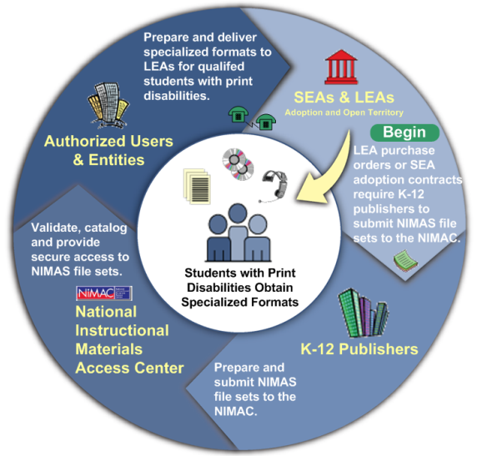
NIMAS System
http://nimas.cast.org

Slide 11
Public Comment
Most comments were technical. They were addressed in the Analysis of Comments and Changes section published July 19, 2006 in the Federal Register
Change: The NIMAS Development and Technical Assistance Centers’ Technical Group submitted technical changes that were accepted

Slide 12
Public Comment
Many commenters recommended continual maintenance and improvement of the NIMAS so that it remains current with technological advances

Slide 13
Public Comment
Comments about implementation of NIMAS or NIMAC were addressed in the Part B Final Regulations in the Access to Instructional Materials and Purchase of Instructional Materials sections
Changes: Four changes were made regarding these provisions

Slide 14
Revisions (TB 2-2)
34 CFR 300.172, regarding access to instructional materials, has been revised:
  to make clear that States must adopt the NIMAS, published on July 19, 2006 and is also included as Appendix C to these final regulations
  to clarify that a State is required to establish a State definition of “timely manner,” —regardless of whether the State does or does not coordinate with the NIMAC

Slide 15
Revisions (cont.) (TB 3-3)
to meet its responsibility to ensure provision of accessible materials in a timely manner, the SEA must ensure that all public agencies take all reasonable steps to provide those materials at the same time as other children receive instructional materials

Slide 16
Key Issue (TB 4-6)
Because the NIMAC is not required to serve all children with disabilities who need accessible materials,…LEAs still are responsible for ensuring that children with disabilities who need instructional materials in accessible formats, but who do not fall within the definition of children who are eligible to receive materials produced from NIMAS files obtained through the NIMAC, receive them in a timely manner

Slide 17
Web Resources
NIMAS Development and TA Centers
  http://nimas.cast.org
    State Directors of Special Education NIMAS Implementation Checklist
    Frequently Asked Questions (Q&A)
    Contact chitchcock@cast.org for NIMAS training

Slide 18
Web Resources
ed.gov web site
  http://www.ed.gov/policy/speced/guid/idea/ monitor/nimac.html
    States that are coordinating with NIMAC
NIMAC web site
  http://nimac.us
    Frequently Asked Questions (Q&A)

Slide 19
Regional Implementation
Planning Meetings
What implementation issues and challenges on this topic should be addressed at the IDEA Regional Implementation Planning Meetings?
    January 30 and 31, 2007
      Washington, D.C.
    February 12 and 13, 2007
      Los Angeles, California
    February 15 and 16, 2007
      Kansas City, Missouri

Slide 20
For More Information
Please go to
http://sites.ed.gov/idea
for resources on IDEA
2004 Final Regulations

Slide 21
NIMAS
Implementation
Challenges?

